Slide 1
CODE DESIGN
SPECIAL JAVA SUBJECT FSOFT – Developer – Part1

Slide 2
Agenda
Algorithmic Problem Solving
What is an Algorithm?
Pseudo Code
Flowchart
Naming Convention
Variables
The Structure Theorem
Communication between modules

Slide 3
Algorithmic Problem Solving
What is an algorithm?
Lists the steps involved in accomplishing a task (like a recipe)
Defined in programming terms as a set of detailed and ordered instructions developed to describe the processes necessary to produce the desired output from a given input’
An algorithm must:
Be lucid, precise and unambiguous
Give the correct solution in all cases
Eventually end

Slide 4
Algorithmic Problem Solving
Pseudo Code: What is Pseudo Code?
Detailed and readable description (in structured English) of what a computer program or algorithm must do (states the steps to the problem solution)
Statements are written in simple English
Each instruction/step is written on a separate line
Keywords and indentation are used to signify particular control structures
Each set of instructions is written from top to bottom, with only one entry and one exit
Used as a detailed step in the process of developing a program. It allows designers or lead programmers to express the design in great detail and provides programmers a detailed template for the next step of writing code in a specific programming language

Slide 5
Algorithmic Problem Solving
Pseudo Code: Guidelines 1/3
There are six basic computer operations:
A computer can receive information
A computer can put out information
A computer can perform arithmetic
A computer can assign a value to a variable or memory location
A computer can compare two variables and select one of two alternate actions
A computer can repeat a group of actions
Notes:
1. A computer can receive information
Read (information from a file)
Get (information from the keyboard)
2. A computer can put out information
Write (information to a file)
Display (information to the screen)
3. A computer can perform arithmetic
Use actual mathematical symbols or the words for the symbols
Add number to total
Total = total + number
+, -, *, /
Calculate, Compute also used
4. A computer can assign a value to a piece of data
3 cases
To give data an initial value
Initialize, Set
To assign a value as a result of some processing
‘=’
* x = 5 + y
To keep a piece of information for later use
Save, Store
5. A computer can compare two piece of information and select one of two alternative actions
IF condition THEN
Some action
ELSE
Alternative action
ENDIF
6. A computer can repeat a group of actions
WHILE condition (is true)
Some action
ENDWHILE
FOR a number of times
Some action
ENDFOR

Slide 6
Algorithmic Problem Solving
Pseudo Code: Guidelines 2/3
The keywords used for pseudocode in this document are:
for start and finish BEGIN MAINPROGRAM, END MAINPROGRAM
for initialisation INITIALISATION, END INITIALISATION
for subprogram BEGIN SUBPROGRAM, END SUBPROGRAM
for selection IF, THEN, ELSE, ENDIF
for multi-way selection CASEWHERE, OTHERWISE, ENDCASE
for pre-test repetition WHILE, ENDWHILE
for post-test repetition REPEAT, UNTIL

Slide 7
Algorithmic Problem Solving
Pseudo Code: Guidelines 3/3
Keywords are written in CAPITALS.
Structural elements come in pairs, e.g.
for every BEGIN there is an END
for every IF there is an ENDIF, etc.
Indenting is used to show structure in the algorithm.
The names of subprograms are underlined.
This means that when refining the solution to a problem, a word in an algorithm can be underlined and a subprogram developed.
This feature enables the use of the ‘top-down’ development concept, where details for a particular process need only be considered within the relevant sub-routine.

Slide 8
Algorithmic Problem Solving
Flowchart - Overview
A diagrammatic representation that illustrates the sequence of operations to be performed to get the solution of a problem.
Generally drawn in the early stages of formulating computer solutions.
Facilitate communication between programmers and business people.
Play a vital role in the programming of a problem and are quite helpful in understanding the logic of complicated and lengthy problems. Once the flowchart is drawn, it becomes easy to write the program in any high level language. Often we see how flowcharts are helpful in explaining the program to others. Hence, it is correct to say that a flowchart is a must for the better documentation of a complex program.

Slide 9




Algorithmic Problem Solving
Flowchart - Basic Flowchart Symbols
Rounded box - use it to represent an event which occurs automatically. Such an event will trigger a subsequent action, for example `receive telephone call’, or describe a new state of affairs.
Rectangle or box - use it to represent an event which is controlled within the process. Typically this will be a step or action which is taken. In most flowcharts this will be the most frequently used symbol.
Diamond - use it to represent a decision point in the process. Typically, the statement in the symbol will require a `yes' or `no' response and branch to different parts of the flowchart accordingly.
Circle - use it to represent a point at which the flowchart connects with another process. The name or reference for the other process should appear within the symbol.

Slide 10
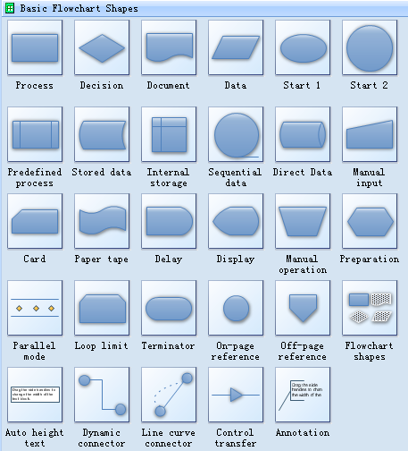
Algorithmic Problem Solving
Flowchart - Guides for drawing flowcharts
Flowcharts are usually drawn using some standard symbols; however, some special symbols can also be developed when required.

Slide 11
Algorithmic Problem Solving
Flowchart - Sample
start
Assignment name?
Pseudocode
Start Program
Prompt for assignment
Set a counter
Loop through grades
Get student grade
Increment counter
End loop
Calculate Average
Print Average
End Program
Set counter = 1
Counter>10?
Student Grade?
Yes
No
Increment Counter
Calculate Average
Print Average
end

Slide 12
Algorithmic Problem Solving
Flow Chart - Practice Time...
Practice 1
Draw a flowchart to find the largest of three numbers A,B, and C
Practice 2
Draw a flowchart to find the sum of first 50 natural numbers

Slide 13
Algorithmic Problem Solving
Naming Conventions 1/2
When designing an algorithm, a programmer must introduce some unique names which represents variables or objects in the problem.
Names should be meaningful.
Names should be transparent to adequately describe variables (Number1, number2, etc.).

Slide 14
Algorithmic Problem Solving
Naming Conventions 2/2
Underscore is used when using more than one word (sales_tax or word_count).
Most programming language does not tolerate a space in a variable as space would signal the end of a variable name.
Another method is to use capital letters as a word separator (salesTax or wordCount).

Slide 15
Algorithmic Problem Solving
Variables: Using & Naming 1/2
Variable: a memory location whose contents can vary; also called an identifier
Each programming language has it own rules for naming identifiers, including:
Legal characters
Maximum length
Use of upper or lower case
Variable name must be a single word, but can be formed from several words
rate, interestRate, interest_rate

Slide 16
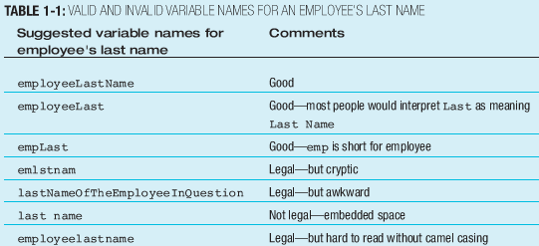
Algorithmic Problem Solving
Variables: Using & Naming 2/2
Choose meaningful names for variables
Improves the readability & maintainability of code

Slide 17
Legal Identifiers
Identifiers must start with a letter, a currency character ($), or a connecting character such as the underscore ( _ ). Identifiers cannot start with a number!
After the first character, identifiers can contain any combination of letters, currency characters, connecting characters, or numbers.
In practice, there is no limit to the number of characters an identifier can contain.
You can't use a Java keyword as an identifier
Identifiers in Java are case-sensitive; foo and FOO are two different identifiers.

Slide 18
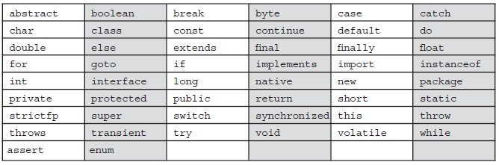
Complete List of Java Keywords

Slide 19
Java Code Conventions
Classes: the names should typically be nouns
Dog
Account
PrintWriter
Interfaces: the names should be adjectives
Runnable
Serializable
Methods: the names should be verb-noun pairs.
getBalance
doCalculation
setCustomerName

Slide 20
Java Code Conventions
Variables: Like methods, starting with a lowercase letter. Sun recommends short, meaningful names, which sounds good to us. Some examples:
buttonWidth
accountBalance
myString
Constants: Java constants are created by marking variables static and final. They should be named using uppercase letters with underscore characters as separators:
MIN_HEIGHT

Slide 21
Algorithmic Problem Solving
Variables: Assigning Values to Variables
Assignment statement:
Assigns a value to a variable
Variable must appear on the left side, value on the right side of the assignment operator
Right side may be an expression that will be evaluated before storing the value in the variable
Assignment operator: the equal sign (=) in most languages
Variable:
Memory location: has an address and a value
Value (contents) is used for various operations

Slide 22
Algorithmic Problem Solving
Variables: Data Types 1/3
Two basic data types:
Text
Numeric
Numeric data stored by numeric variables
Text data stored by string, text, or character variables
Constants:
Values that do not change while the program is running
Have identifiers, and can be used like variables for calculations, but cannot be assigned new values

Slide 23
Algorithmic Problem Solving
Variables: Data Types 2/3
Some programming languages implement several numeric data types, such as:
Integer: whole numbers only
Floating-point: fractional numeric values with decimal points
Character or string data is represented as characters enclosed in quotation marks
“x”, “color”
Data types must be used appropriately

Slide 24
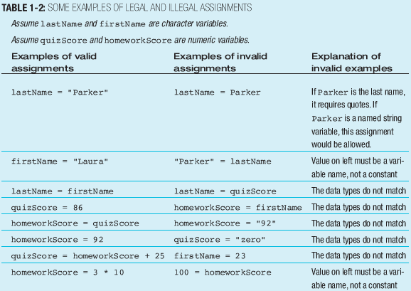
Algorithmic Problem Solving
Variables: Data Types 3/3

Slide 25
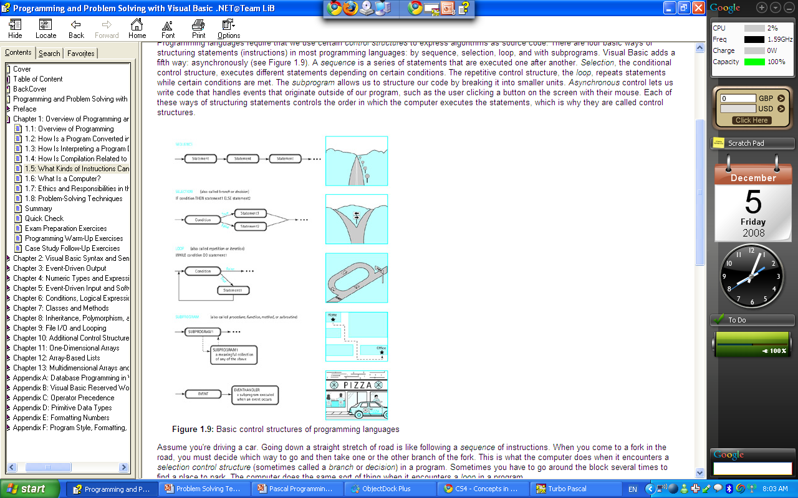
Algorithmic Problem Solving
The Structure Theorem – Overview 1/6
Three basic rules
1) Sequence
Get up from bed
Dress up
Go to the shower
Go to work
2) Selection
If car is broken, go to work by bus. Otherwise go to work by car
3) Repetition
Drink until the bottle is empty

Slide 26
Algorithmic Problem Solving
The Structure Theorem – Overview 2/6
It is considered good practice for a single flowchart
never to exceed the bounds of one page.
If a flowchart does not fit on one page,
this is one instance in which the better solution is to use refinement
which results in the creation of subprograms.
Subprograms on separate pages are more desirable than using a connector to join flowcharts over more than one page.
A flowchart expressing the solution to an involved problem may have:
the main program flowchart on one page
with subprograms continuing the problem solution on subsequent pages.
Regardless of page size, it is also important to start any complex algorithm with:
a clear, uncluttered main line.
This should reference the required subroutines
whose detail is shown in separate flowcharts.

Slide 27
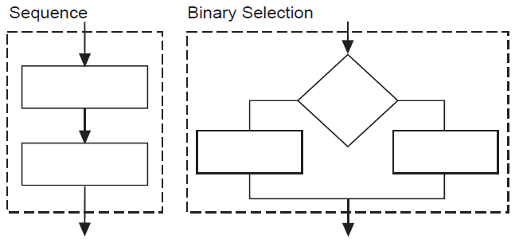
Algorithmic Problem Solving
The Structure Theorem – Overview 3/6
Each of the five acceptable structures can be built from the basic elements as shown below.

Slide 28
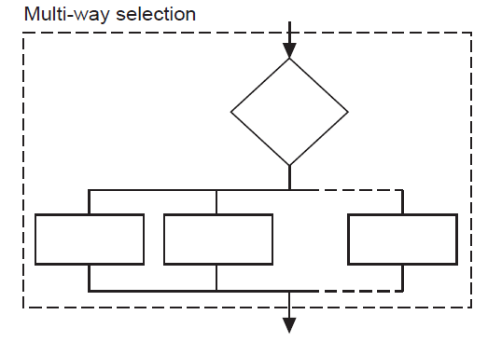
Algorithmic Problem Solving
The Structure Theorem – Overview 4/6
Each of the five acceptable structures can be built from the basic elements as shown below.

Slide 29
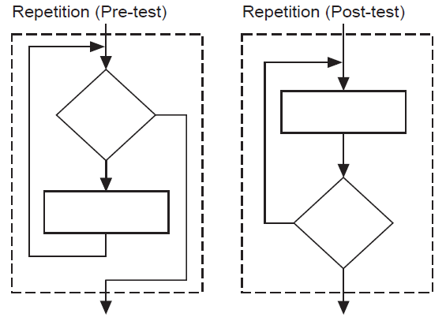
Algorithmic Problem Solving
The Structure Theorem – Overview 5/6
Each of the five acceptable structures can be built from the basic elements as shown below.

Slide 30
Algorithmic Problem Solving
The Structure Theorem – Overview 6/6
Each of the five acceptable structures can be built from the basic elements as shown previously.
In all cases note there is:
only one entry point to the structure
and one exit point as indicated by the dashed boxes.
Since each structure can be thought of as a process
(as shown by the dashed boxes containing the structure),
more complex algorithms can be constructed by replacing any single process by one or other of the structures.

Slide 31
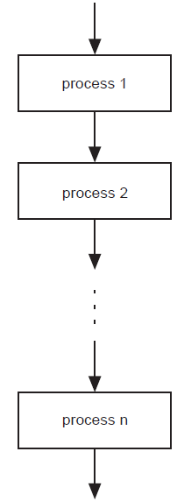
Algorithmic Problem Solving
The Structure Theorem - Sequence
In a computer program or an algorithm, sequence involves simple steps which are to be executed one after the other. The steps are executed in the same order in which they are written.
In pseudocode,
sequence is expressed as:
process 1
process 2
…
…
process n
In a flowchart,
sequence is expressed as:
(The arrowheads are optional if the flow is top-to-bottom.)

Slide 32
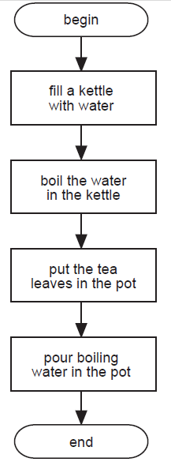
Algorithmic Problem Solving
The Structure Theorem – Sequence Example
Problem: Write a set of instructions that describe how to make a pot of tea.
Flowchart
Pseudocode
BEGIN
fill a kettle with water
boil the water in the kettle
put the tea leaves in the pot
pour boiling water in the pot
END

Slide 33
Algorithmic Problem Solving
The Structure Theorem - Selection
Selection is used in a computer program or algorithm
to determine which particular step or set of steps is to be executed.
A selection statement can be used to choose a specific path dependent on a condition.
There are two types of selection:
binary (two-way branching) selection and
multi-way (many way branching) selection.
Following is a description of each.
Binary Selection
As the name implies, binary selection allows the choice
between two possible paths.
If the condition is met then one path is taken,
otherwise the second possible path is followed.
In the examples that follow, the first case described requires a process to be completed only if the condition is true.
The process is ignored if the condition is false.
In other words there is only one path that requires processing to be done, so the processing free path is left out rather than included saying ‘do nothing’.
Multi-way Selection
Multi-way selection allows for any number of possible choices, or cases.
The path taken is determined by the selection of the choice which is true.
Multi-way selection is often referred to as a case structure.

Slide 34
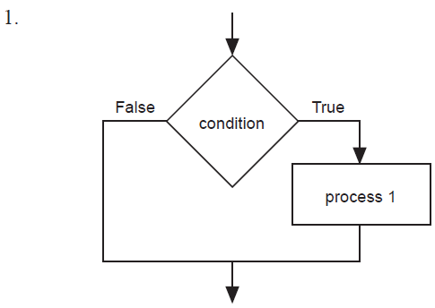
Algorithmic Problem Solving
The Structure Theorem – Binary Selection 1/3
Selection is used in a computer program or algorithm
to determine which particular step or set of steps is to be executed.
Binary Selection
In pseudocode, binary selection is expressed in the following ways:
IF condition THEN
process 1
ENDIF
IF condition THEN
process 1
ELSE
process 2
ENDIF
Binary Selection
In flowcharts, binary selection is expressed in the following ways:

Slide 35
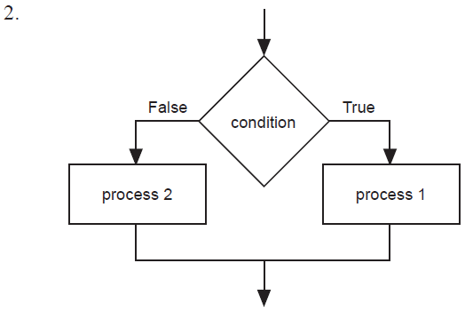
Algorithmic Problem Solving
The Structure Theorem – Binary Selection 2/3
Selection is used in a computer program or algorithm
to determine which particular step or set of steps is to be executed.
Binary Selection
In pseudocode, binary selection is expressed in the following ways:
IF condition THEN
process 1
ENDIF
IF condition THEN
process 1
ELSE
process 2
ENDIF
Binary Selection
In flowcharts, binary selection is expressed in the following ways:

Slide 36
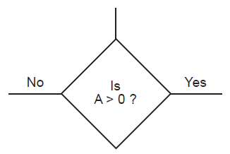
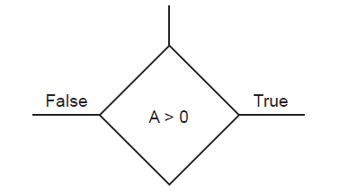
Algorithmic Problem Solving
The Structure Theorem – Binary Selection 3/3
Note: In a flowchart it is most important to indicate
which path is to be followed when the condition is true, and
which path to follow when the condition is false.
Without these indications the flowchart is open to more than one interpretation.
Note: There are two acceptable ways to represent a decision in all of the structures.
Either method is acceptable. For consistency, the method 1 is used throughout this document.
The condition is expressed as a statement and the two possible outcomes are indicated by
True
False
2. The condition is expressed as a question and the two possible outcomes are indicated by
Yes
No

Slide 37
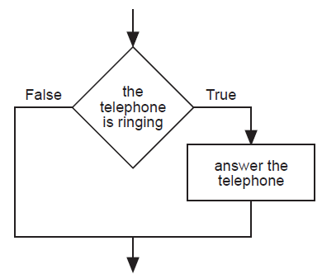
Algorithmic Problem Solving
The Structure Theorem – Binary Selection Examples 1/2
Selection is used in a computer program or algorithm
to determine which particular step or set of steps is to be executed.
Examples Using Binary Selection
Problem 1: Write a set of instructions to describe when to answer the phone.
Binary Selection
Pseudocode
IF the telephone is ringing THEN
answer the telephone
ENDIF
Binary Selection
Flowchart

Slide 38
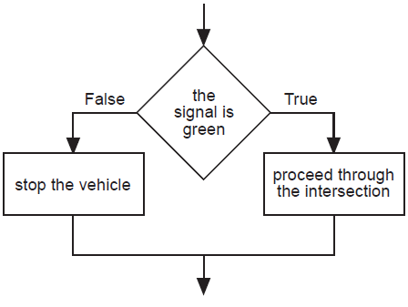
Algorithmic Problem Solving
The Structure Theorem – Binary Selection Examples 2/2
Selection is used in a computer program or algorithm
to determine which particular step or set of steps is to be executed.
Examples Using Binary Selection
Problem 2: Write a set of instructions to follow when approaching a set of traffic control lights.
Binary Selection
Flowchart
Binary Selection
Pseudocode
IF the signal is green THEN
proceed through the intersection
ELSE
stop the vehicle
ENDIF

Slide 39
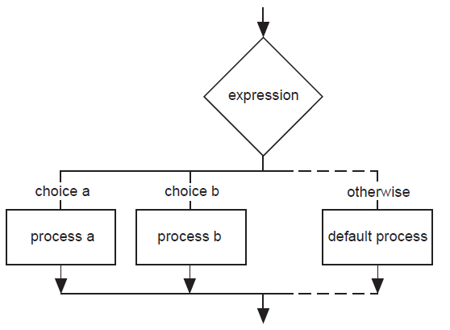
Algorithmic Problem Solving
The Structure Theorem – Multi-way Selection
Selection is used in a computer program or algorithm
to determine which particular step or set of steps is to be executed.
Multi-way Selection
In pseudocode, multiple selection is expressed as:
CASEWHERE expression evaluates to
choice a : process a
choice b : process b
. .
. .
. .
OTHERWISE : default process
ENDCASE
Note: As the flowchart version of the multi-way selection indicates, only one process on each pass is executed as a result of the implementation of the multi-way selection.
Multi-way Selection
In flowcharts, multi-way selection is expressed as:

Slide 40
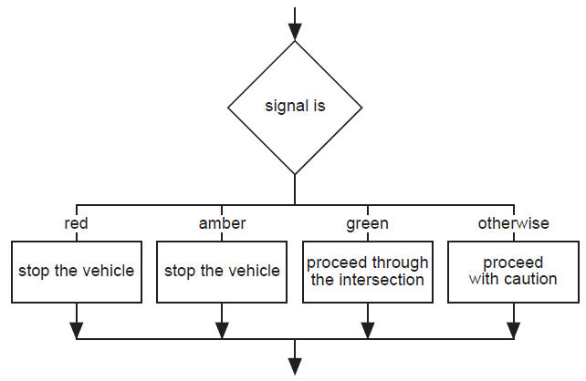
Algorithmic Problem Solving
The Structure Theorem – Multi-way Selection Examples
Selection is used in a computer program or algorithm
to determine which particular step or set of steps is to be executed.
Example Using Multi-way Selection
Problem: Write a set of instructions that describes how to: respond to all possible signals at a set of traffic control lights.
Multi-way Selection
Flowchart
Multi-way Selection
Pseudocode
CASEWHERE signal is
red : stop the vehicle
amber : stop the vehicle
green : proceed through the intersection
OTHERWISE : proceed with caution
ENDCASE

Slide 41
Algorithmic Problem Solving
The Structure Theorem – Repetition 1/3
Repetition allows for a portion of an algorithm or computer program
to be done any number of times
dependent on some condition being met.
An occurrence of repetition is usually known as a loop.
An essential feature of repetition is that
each loop has a termination condition
to stop the repetition,
or the obvious outcome is that
the loop never completes execution (an infinite loop).
The termination condition can be checked or tested
at the beginning and is known as a pre-test loop or
at the end of the loop and is known as a post-test loop.

Slide 42
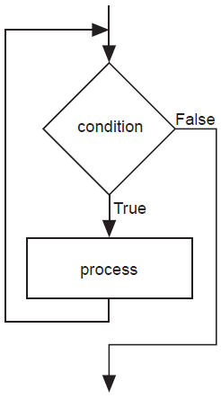
Algorithmic Problem Solving
The Structure Theorem – Repetition 2/3
Repetition allows for a portion of an algorithm or computer program to be done any number of times dependent on some condition being met. An occurrence of repetition is usually known as a loop.
Repetition: Pre-Test
A pre-tested loop is so named because the condition has to be met at the very beginning of the loop or the body of the loop is not executed.
This construct is often called a guarded loop.
The body of the loop is executed repeatedly while the termination condition is true.
Repetition
In flowcharting
pre-test repetition
is expressed as:
Repetition
In pseudocode, pre-test repetition is expressed as:
WHILE condition is true
process(es)
ENDWHILE

Slide 43
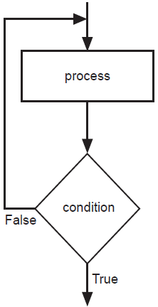
Algorithmic Problem Solving
The Structure Theorem – Repetition 3/3
Repetition allows for a portion of an algorithm or computer program to be done any number of times dependent on some condition being met. An occurrence of repetition is usually known as a loop.
Repetition: Post-Test
A post-tested loop executes the body of the loop before testing the termination condition.
This construct is often referred to as an unguarded loop.
The body of the loop is repeatedly executed until the termination condition is true.
An important difference between a pre-test and post-test loop is that the statements of a post-test loop are executed at least once even if the condition is originally true, whereas the body of the pre-test loop may never be executed if the termination condition is originally true.
A close look at the representations of the two loop types makes this point apparent.
Repetition
In pseudocode, post-test repetition is expressed as:
REPEAT
process
UNTIL condition is true
Repetition
In a flowchart
post-test repetition
is expressed as:

Slide 44
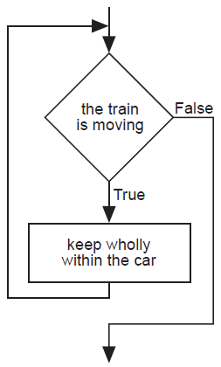
Algorithmic Problem Solving
The Structure Theorem – Repetition Examples 1/2
Repetition allows for a portion of an algorithm or computer program to be done any number of times dependent on some condition being met. An occurrence of repetition is usually known as a loop.
An Example Using Pre-Test Repetition
Problem: Determine a safety procedure for travelling in a carriage on a moving train.
Pre-test Repetition
Flowchart
Pre-test Repetition
Pseudocode
WHILE the train is moving
keep wholly within the carriage
ENDWHILE

Slide 45
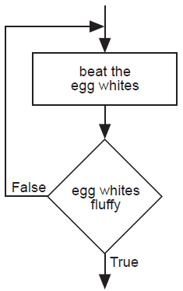
Algorithmic Problem Solving
The Structure Theorem – Repetition Examples 2/2
Repetition allows for a portion of an algorithm or computer program to be done any number of times dependent on some condition being met. An occurrence of repetition is usually known as a loop.
An Example Using Post-Test Repetition
Problem: Determine a procedure to beat egg whites until fluffy.
Post-test Repetition
Pseudocode
REPEAT
beat the egg whites
UNTIL fluffy
Post-test Repetition
Flowchart

Slide 46
Algorithmic Problem Solving
Pseudo codes - Practice Time…
Practice 3 - Write an algorithm with pseudo codes
Request the user to input two numbers. If the sum of those numbers are greater than 12, program outputs "Big numbers you gave". Otherwise the program outputs "Small numbers you gave"
Practice 4 – Write an algorithm with pseudo codes
Computing Weekly Wages;
Gross pay depends on the pay rate and the number of hours worked per week. However, if you work more than 40 hours, you get paid time-and-a-half for all hours worked over 40. Pseudo-code the task of computing gross pay given pay rate and hours worked.

Slide 47
Algorithmic Problem Solving
Pseudo codes - Practice Time…
Practice 5
Pseudo-code the task of computing the final price of an item after figuring in sales tax.
Note the three types of instructions: input (get), process/calculate (=) and output (display)
Note that the operations are numbered and each operation is unambiguous and effectively computable. We also extract and list all variables used in our pseudo-code. This will be useful when translating pseudo-code into a programming language

Slide 48
Algorithmic Problem Solving
The Structure Theorem – Subprograms 1/3
Subprograms, as the name implies, are complete part-programs
that are used from within the main program section.
They allow the process of refinement to be used to develop solutions to problems that are easy to follow.
Sections of the solution are developed and presented in understandable chunks, and because of this,
subprograms are particularly useful when using the top-down method of solution development.
When using subprograms it is important that
the solution expression indicates where the main program branches to a subprogram.
It is equally important to indicate exactly where the subprogram begins.
In pseudocode,
the statement in the main program that is expanded in a subprogram is underlined to indicate that further explanation follows.
The expanded subprogram section should be identified by
using the keywords BEGIN SUBPROGRAM
followed by the underlined title used in the main program.
The end of the subprogram is marked by the keywords END SUBPROGRAM
and the underlined title used in the main program.
When using flowcharts,
a subprogram is shown by an additional vertical line on each side of the process box.
This indicates that the subprogram is expanded elsewhere.
The start and end of the subprogram flowchart uses the name of the subprogram in the termination boxes.

Slide 49
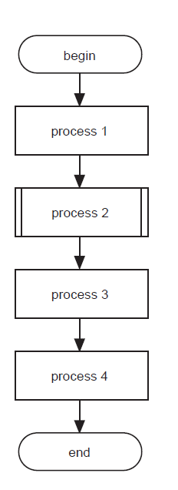
Algorithmic Problem Solving
The Structure Theorem – Subprograms 2/3
Subprograms, as the name implies, are complete part-programs
that are used from within the main program section.
Subprograms
Pseudocode
BEGIN MAINPROGRAM
process l
process 2
process 3
process 4
END MAINPROGRAM
BEGIN SUBPROGRAM process 2
do this
do that
END SUBPROGRAM process 2
Subprograms
Flowchart

Slide 50
Algorithmic Problem Solving
The Structure Theorem – Subprograms 3/3
Subprograms, as the name implies, are complete part-programs
that are used from within the main program section.
In many cases a subprogram can be written to do the same task at two or more points in an algorithm.
Each time the subprogram is called, it may operate on different data.
To indicate the data to be used one or more parameters are used.
The parameters allow the author to write a general algorithm using the formal parameters.
When the subprogram is executed, the algorithm carries out its task on the actual parameters given at the call.
The parameters to be used by a subprogram are provided as a list in parentheses after the name of the subprogram. There is no need to include them at the end of the algorithm.
Example of Using Subprograms with one Parameter in Pseudocode
BEGIN MAINPROGRAM
read (name)
read (address)
END MAINPROGRAM
BEGIN SUBPROGRAM read (array)
Set pointer to first position
Get a character
WHILE there is still more data AND there is room in the array
store data in the array at the position given by the pointer
Increment the pointer
get data
ENDWHILE
END SUBPROGRAM read (array)
The first time that the subprogram ‘read’ is called:
the characters are read into the array called ‘name’
the second time, the data (characters) are read into the array called ‘address’.

Slide 51
Communication between modules
Necessary to consider flow of information between modules
This flow of information is called “intermodule communication” and can be accomplished by the scope of the variable

Slide 52
Communication between modules
Scope of a variable
The portion of a program in which that variable has been defined and to which it can be referenced
Variables can be global where the scope of the variable is the whole program
Scope of the variable is simple the module which it is defined

Slide 53
Communication between modules
Global & Local data
Global data
Data that can be used by all the modules in a program
Every module in the program can access and change data
Lifetime of a global variable spans the execution of the whole program
Local data
Variable are defined within the submodule are called local variables
The scope of a local variable is simply the module in which it is defined
The lifetime of a local variable is limited to the execution of the single submodule in which it is defined

Slide 54
Communication between modules
Side effects
Side effect is a form of a cross-communication of a module with other parts of a program,
Occurs when a subordinate module alters the value of a global variable inside a module

Slide 55
Communication between modules
Passing parameters
Parameters are simply data items transferred from a calling module to its subordinate module at the time of calling
To pass parameters between modules, two things can happen:
The calling module must name the parameters that it wants to pass to the submodule
The submodule must be able to receive those parameters and return them to the calling module if required
Parameters names that appear when a submodule is defined are known as formal parameters
Variables and expressions that are passed to a submodule in a particular call are called actual parameters

Slide 56
Communication between modules
Value and reference parameters
Parameters may have one of three function:
To pass information from a calling module to a subordinate module
To pass information from a subordinate module to its calling module
To fulfil a two-way communication role
Value parameters
Value parameters pass a copy of the value of a parameter from one module to another
Reference parameters
Reference parameter pass the memory address of a parameter from one module to another

Slide 57
Evolution of Programming Techniques
Programming began in the 1940s, using memory addresses and machine code directly
Higher level languages were developed to allow English-like instructions
Older programs were “monolithic,” and ran from beginning to end
Newer programs contain modules that can be combined to form programs

Slide 58
Evolution of Programming Techniques
Two major programming techniques:
Procedural programming
Object-oriented programming
Procedural programming: focuses on
The procedures that programmers create
The actions performed on data
Object-oriented programming: focuses on
The objects that represent real-world things and their attributes and behaviors
Both techniques employ reusable program modules

Slide 59


